Slide 1
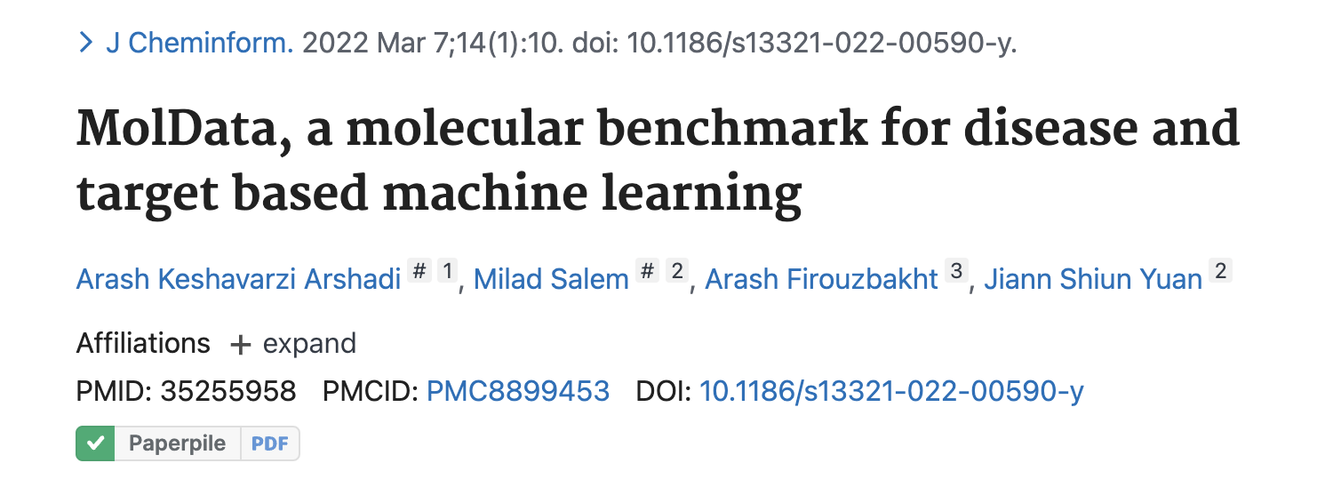
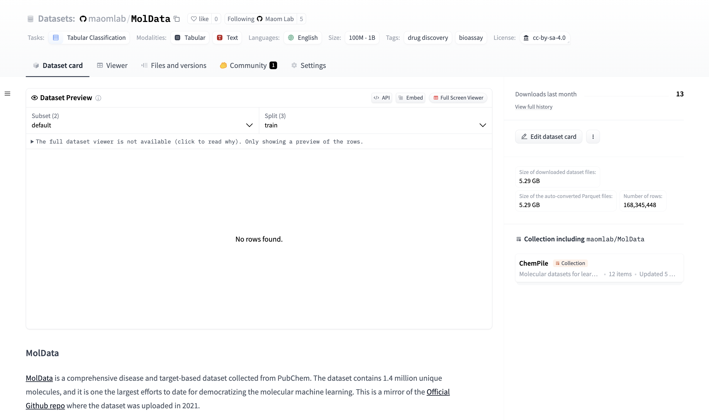
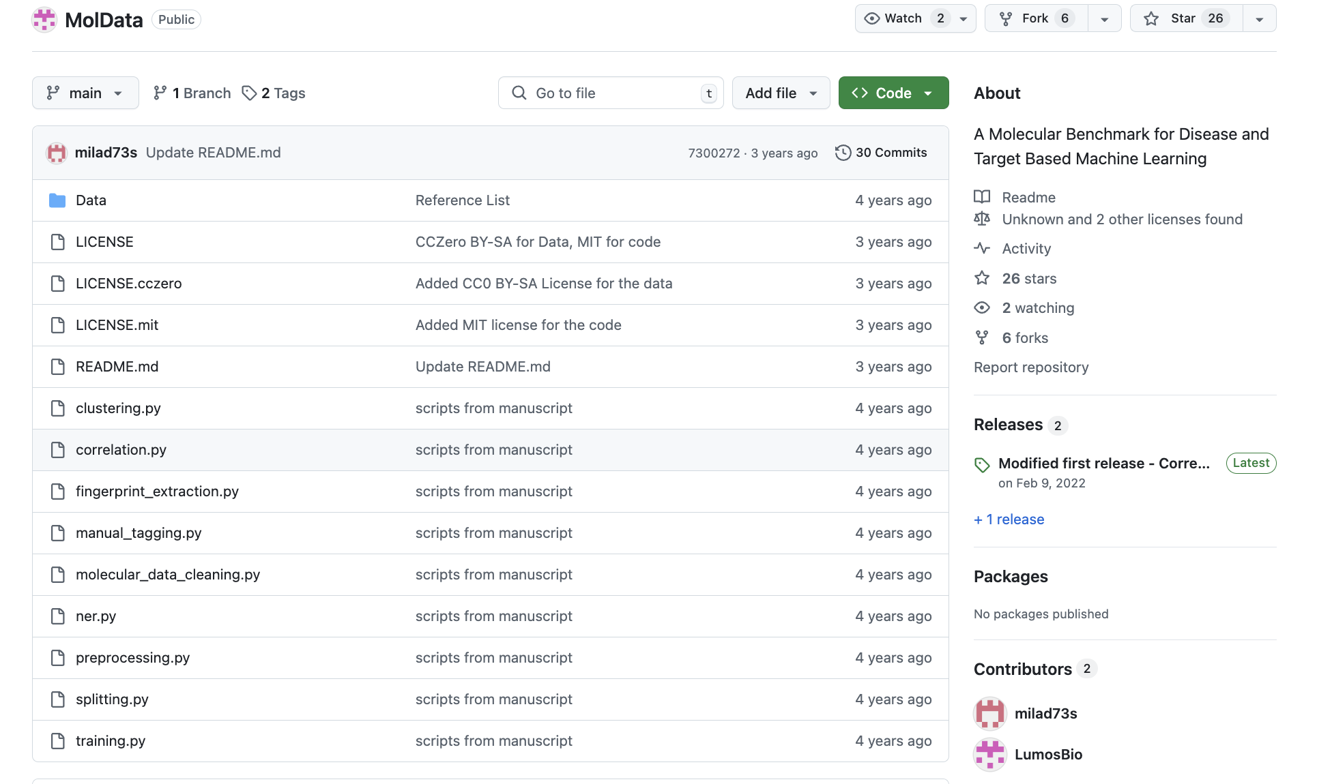
Lab 4 Recap
1) Why are we curating data and putting on hugging face?
mol_data = datasets.load_dataset(
"maomlab/MolData",
name = "MolData",
cache_dir = parameters['hf_cache_dir'])
mol_data_train = mol_data['train'].to_pandas()
# 168,345,448 rows

Slide 2
Lab 4 Recap
What to do when it’s hard?
Ask LLMs (ChatGPT, DeepSeek, Claud)
Come to office hours (Tuesdays 9-1am)
Ask on Slack, email, canvas
Specific issues people faced
Installing packages, setting up environment => often frustrating, good news is once it’s set up you’re good to go
Getting errors when running the code
Read error messages carefully
Try to simplify the problem to make a “reproducible example”
Find a related version that works and “bisect” differences
Access tokens for pushing data to HF
Based on feedback I’ve updated the instructions to be clearer, so thank you.
Not enough time Friday -> Tuesday:
Extend deadlines Friday -> Friday
This week will pick continue with a the MolData dataset, from HF, so more practice on command line
Goal is to practice and learn
grades will reflect effort and progress
If you don’t complete the assignments, describe what where you got stuck and what you tried

Slide 3
Supervised Machine Learning
BIOINF595
2/11/2025
Matthew O’Meara

Slide 4
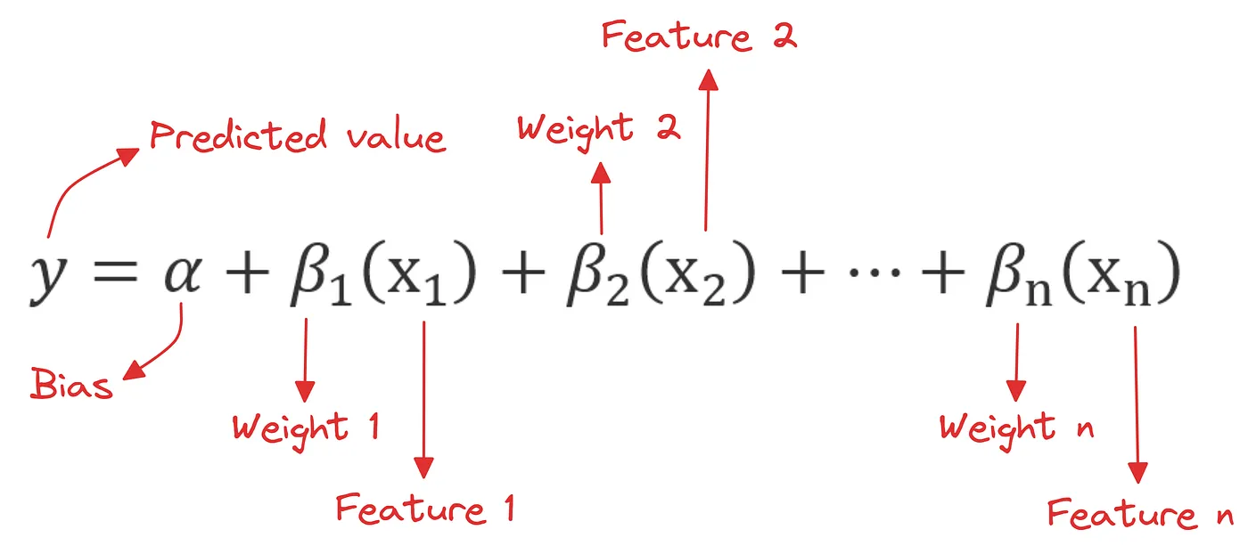
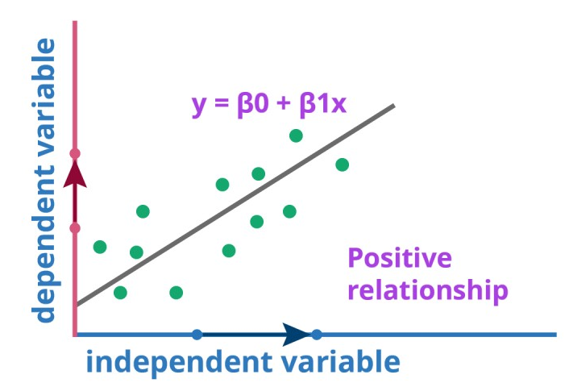
Linear Regression

Slide 5
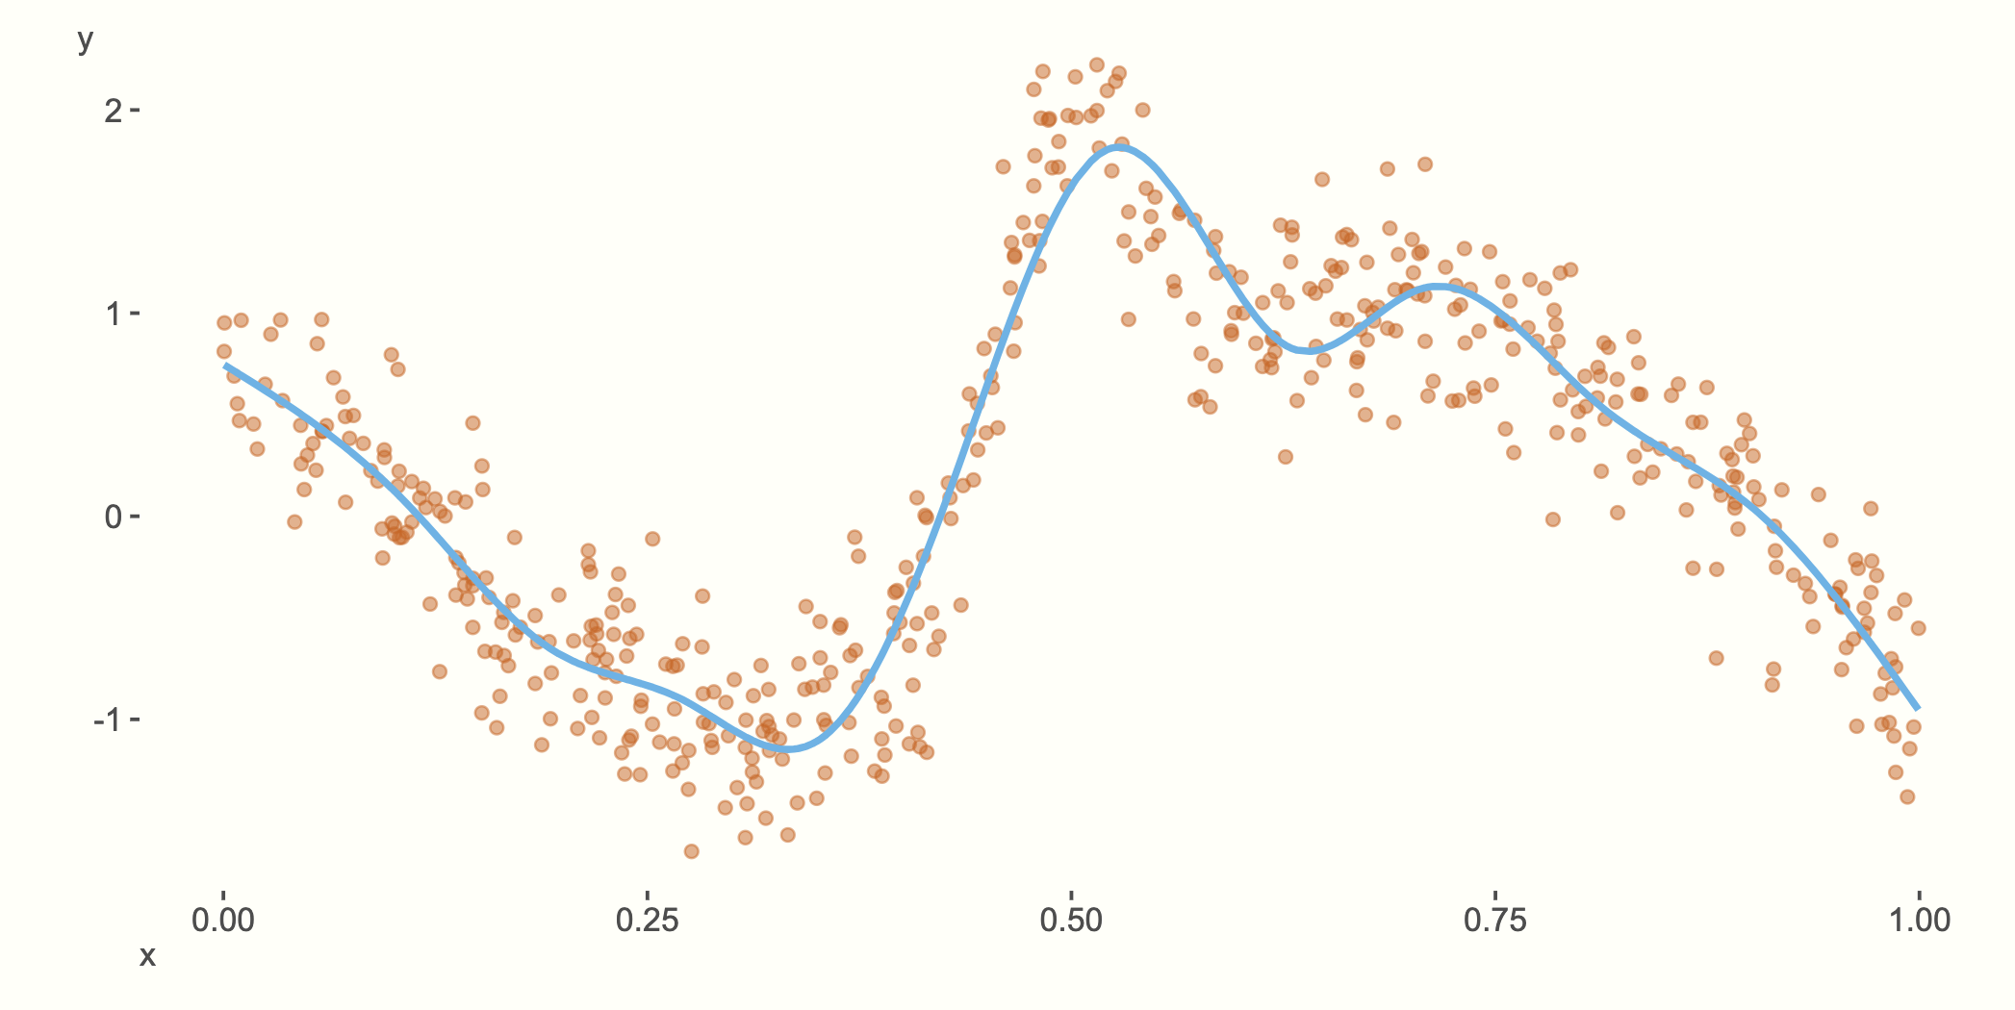
General Linear Models / General Additive Models
Transform linear terms through non-linear link functions
Binary <-> logistic
Counts <-> Poisson/negative binomial
Survival <-> Cox
Smooth <-> polynomial splines
Hierarchical models
Shared effects across groups
Heteroscedastic models
Allow for non-uniform “noise”
Notes:
https://m-clark.github.io/generalized-additive-models/building_gam.html

Slide 6
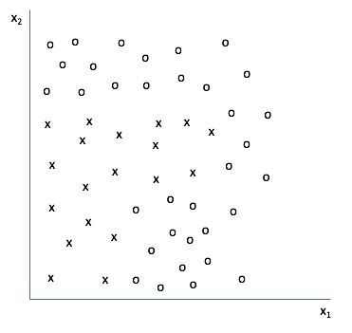
Supervised Machine Learning

Slide 7
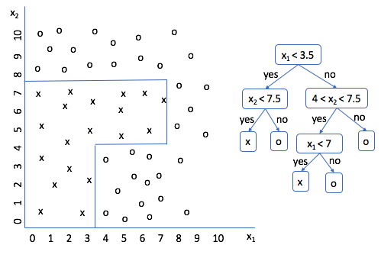
Supervised Machine Learning

Slide 8
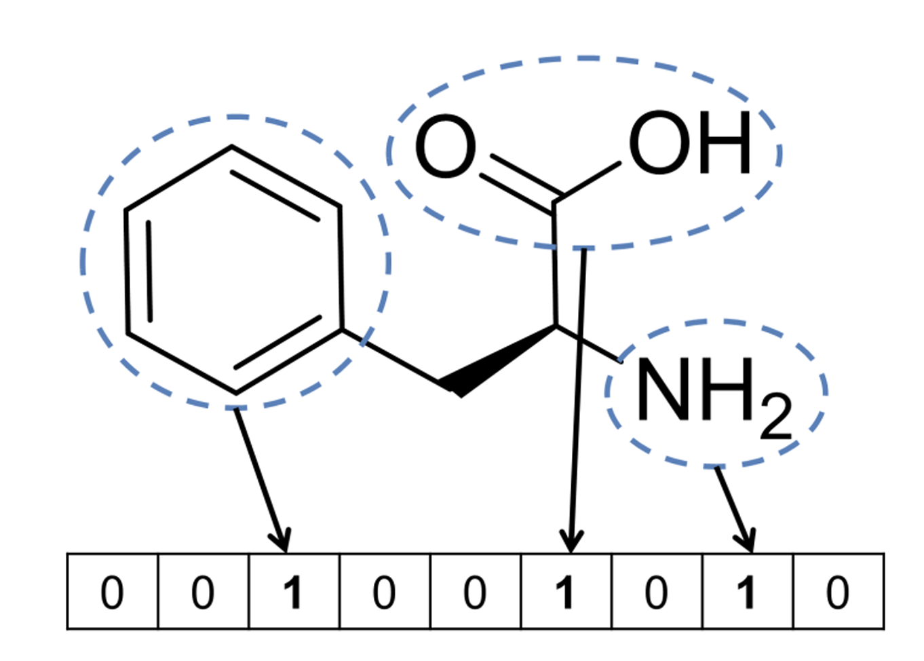
Fingerprint based machine learning
Active / Decoy
Label
Extended connectivity fingerprint (ECFP)
Molecule graph -> bit vector
Fingerprint
Predict
Compound
(Bajusz, et al., 2017)
(Rogers, Hahn, JCIM, 2010)

Slide 9
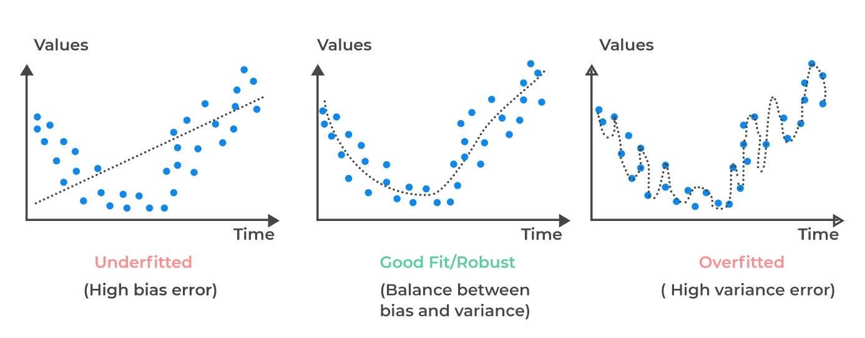
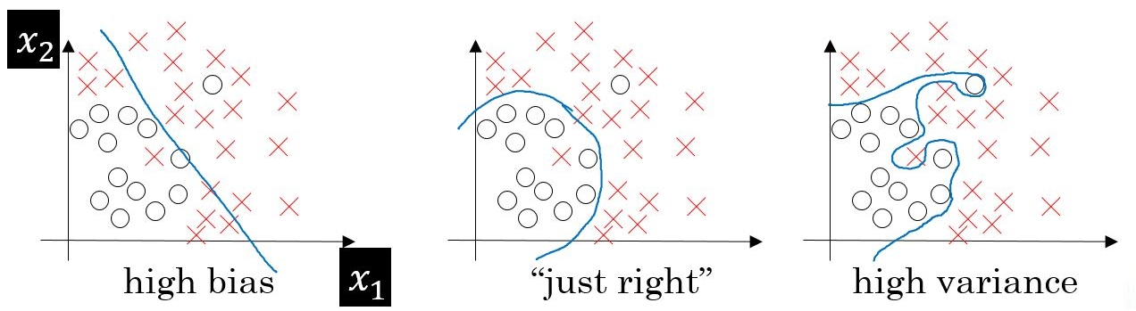
Bias Variance Tradeoff
Notes:
https://www.oreilly.com/library/view/machine-learning-quick/9781788830577/80e18c81-d805-4dec-9993-cde9ffed7a3c.xhtml
https://medium.com/@senihberkay/bias-variance-trade-off-overfitting-underfitting-polynomial-regression-46d5fa53c4bf

Slide 10
Bias Variance Tradeoff
Notes:
https://www.oreilly.com/library/view/machine-learning-quick/9781788830577/80e18c81-d805-4dec-9993-cde9ffed7a3c.xhtml
https://medium.com/@senihberkay/bias-variance-trade-off-overfitting-underfitting-polynomial-regression-46d5fa53c4bf

Slide 11
Bias Variance Tradeoff
Notes:
https://www.oreilly.com/library/view/machine-learning-quick/9781788830577/80e18c81-d805-4dec-9993-cde9ffed7a3c.xhtml
https://medium.com/@senihberkay/bias-variance-trade-off-overfitting-underfitting-polynomial-regression-46d5fa53c4bf

Slide 12
Bias Variance Tradeoff
Notes:
https://www.oreilly.com/library/view/machine-learning-quick/9781788830577/80e18c81-d805-4dec-9993-cde9ffed7a3c.xhtml
https://medium.com/@senihberkay/bias-variance-trade-off-overfitting-underfitting-polynomial-regression-46d5fa53c4bf

Slide 13
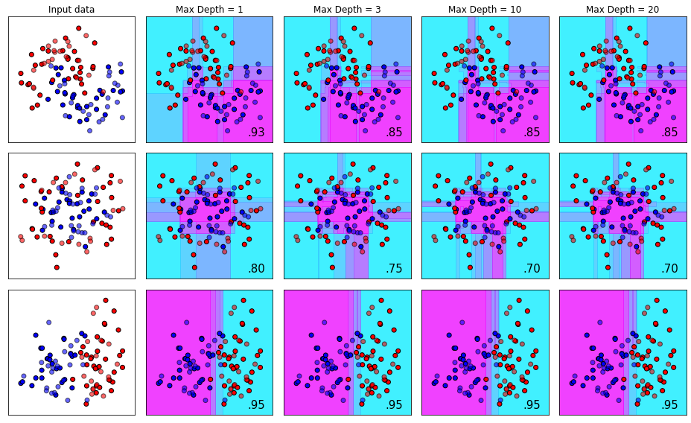
Gradient Boost Decision Tree Models
from xgboost import XGBClassifier
# read data
from sklearn.datasets import make_moons
from sklearn.model_selection import train_test_split
data = make_moons(noise=0.3, random_state=0)
X_train, X_test, y_train, y_test = train_test_split(
data['data'], data['target’],
test_size=.2)
# create model instance
bst = XGBClassifier(
n_estimators=2,
max_depth=3,
learning_rate=1,
objective='binary:logistic’)
# fit model
bst.fit(X_train, y_train)
# make predictions
preds = bst.predict(X_test)
Notes:
https://thirsty-lamarr-6d212e.netlify.app/post/xgboost-tuning-visuals/

Slide 14
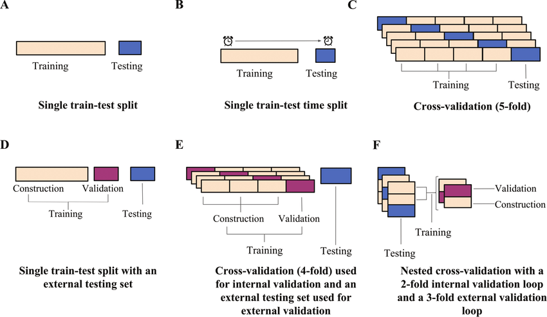
Cross Validation Schemes
(Mathai, et al., 2019)

Slide 15
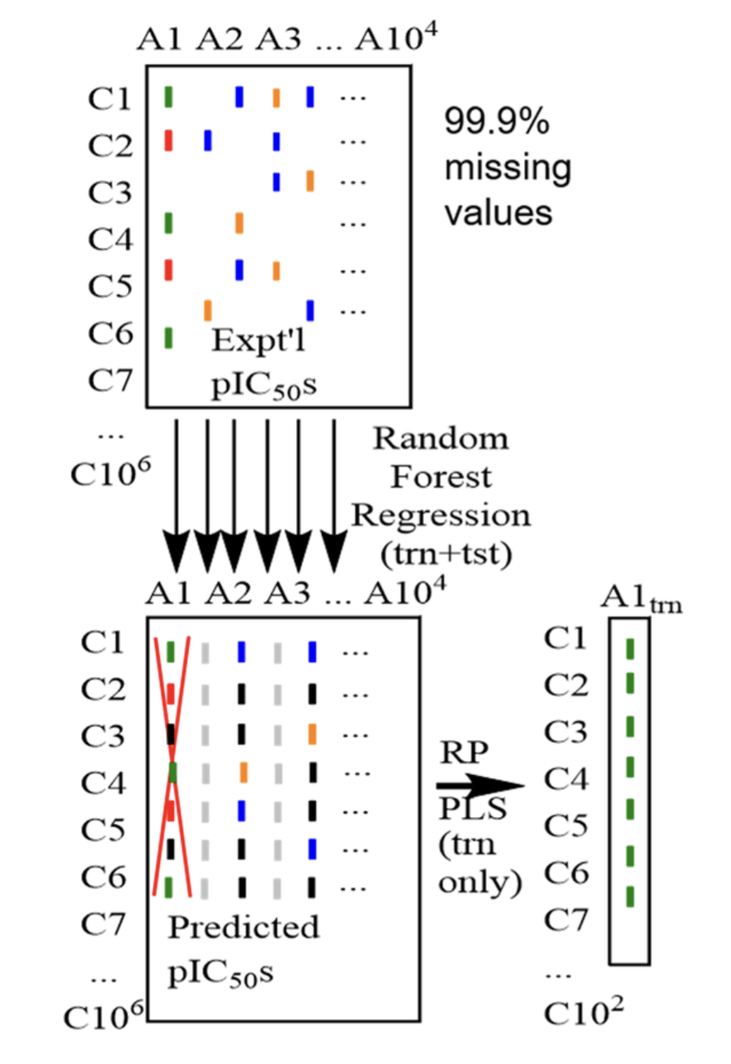
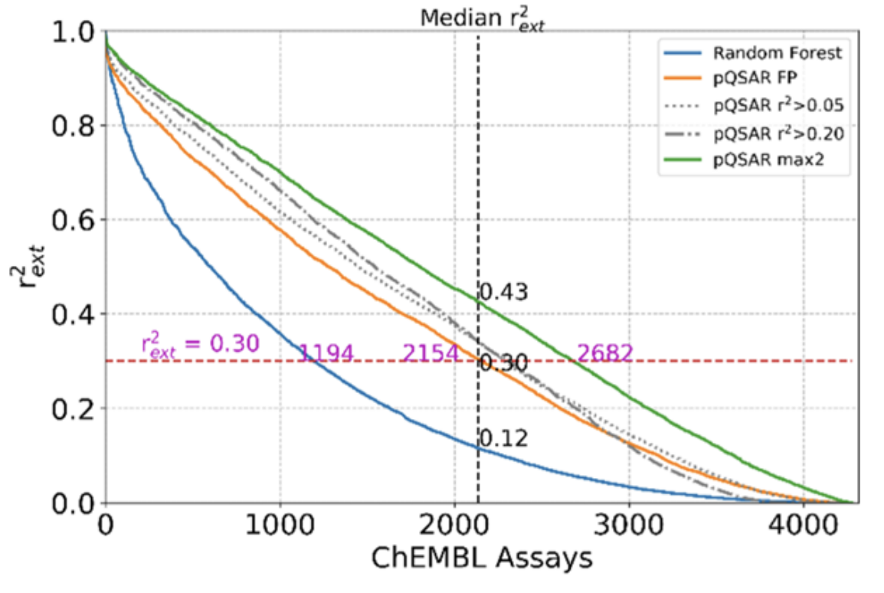
Set up the experiment (training/testing) to match how you want the model to generalize
(Martin, et al., 2019)

Slide 16
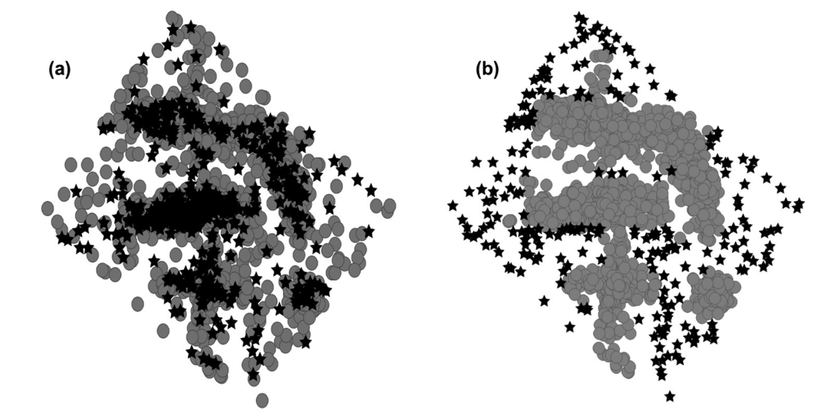
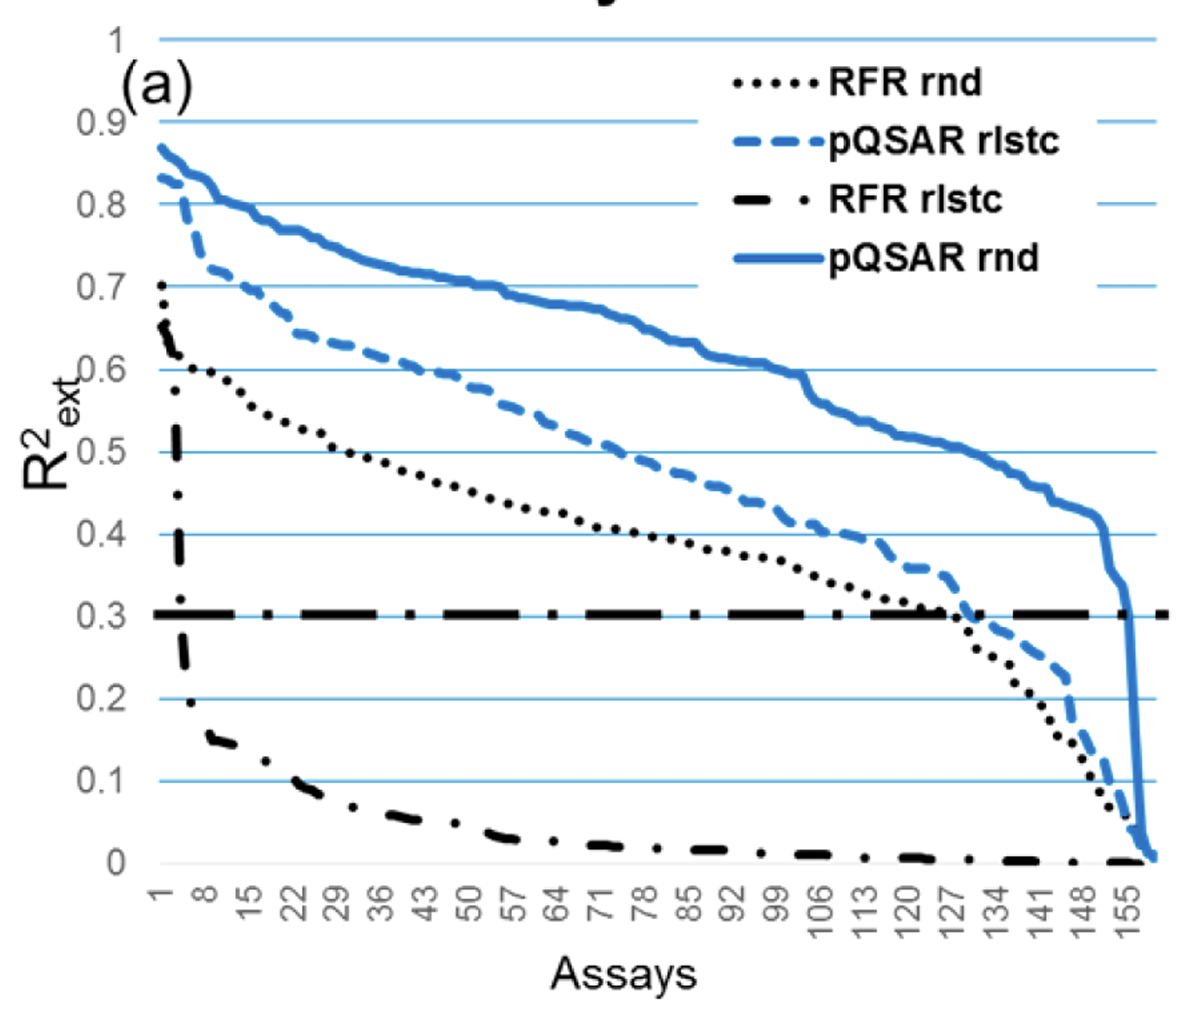
Cluster based train/test split: Train on largest clusters, test on smallest cluster

Slide 17
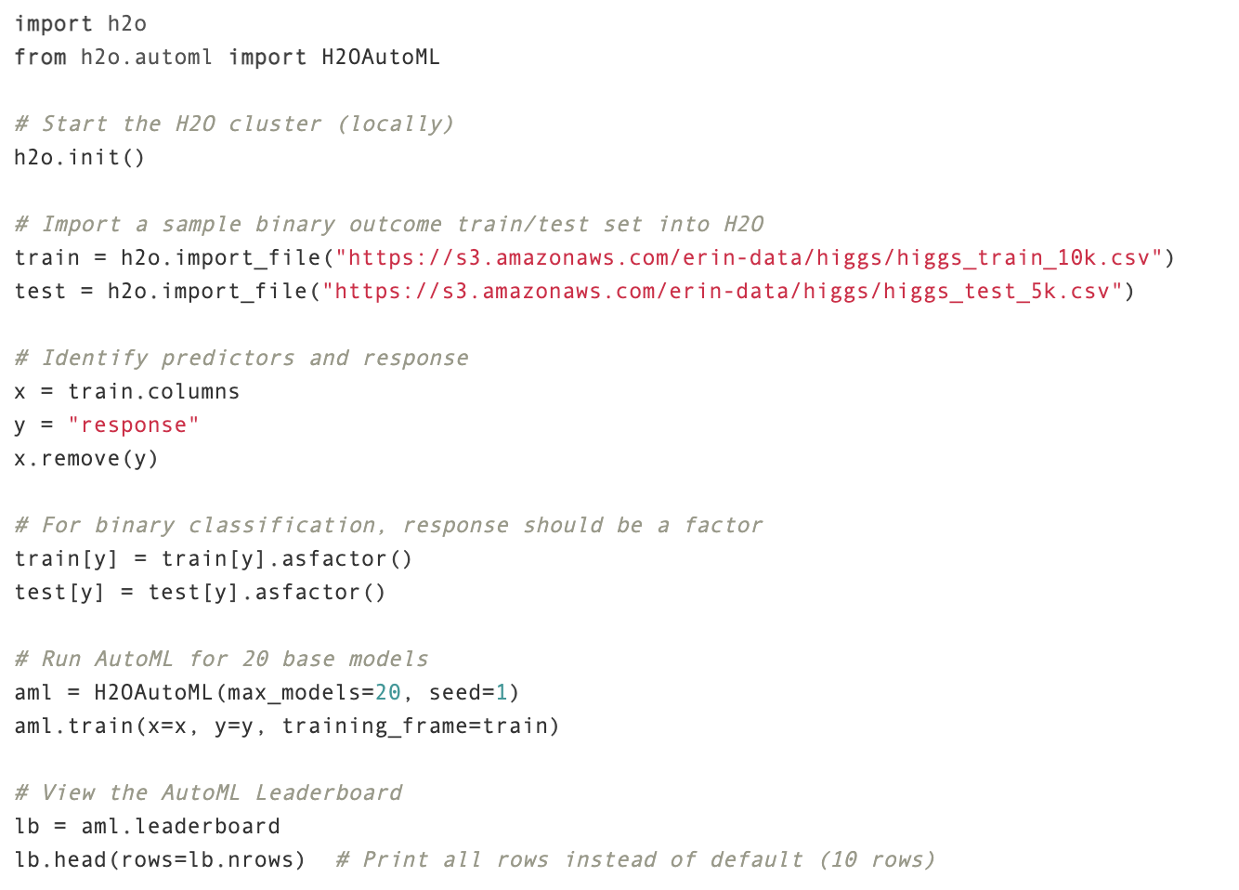

H2O AutoML
Try lots of different models
Search hyperparameters
Combine different models together

Slide 18
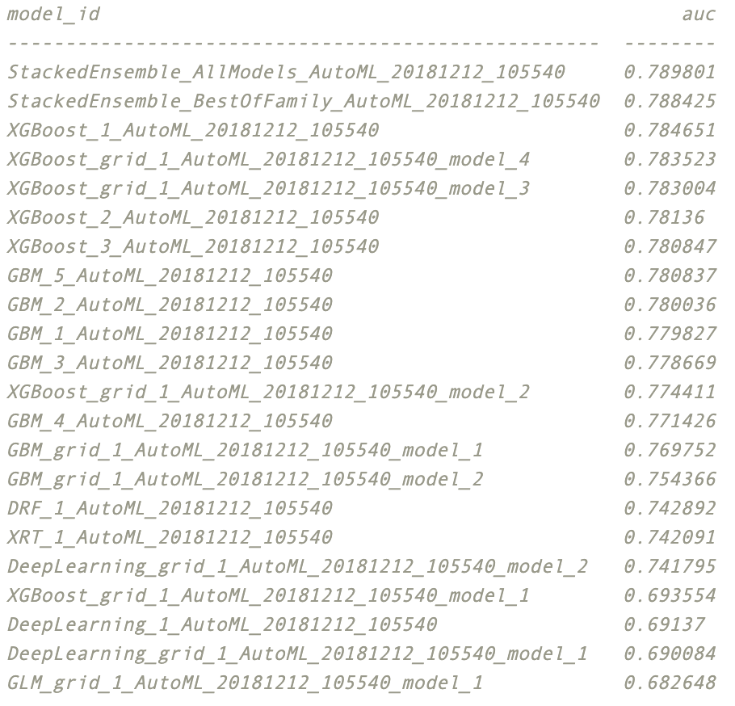
H2O AutoML
Try lots of different models
Search hyperparameters
Combine different models together

Slide 19
Ingredients for deep learning success
Effective utilization of graphical processing units (GPUs)
Automatic differentiation
Stochastic gradient descent
Over-parameterization
Under-parameterization: bias/variance trade-off => generalization
Over-parameterization: big-data + regularization => generalization
Trainable simulations
Plug-and-play differentiable modules
Encode data invariants
Generative models <---> simulations

Slide 20
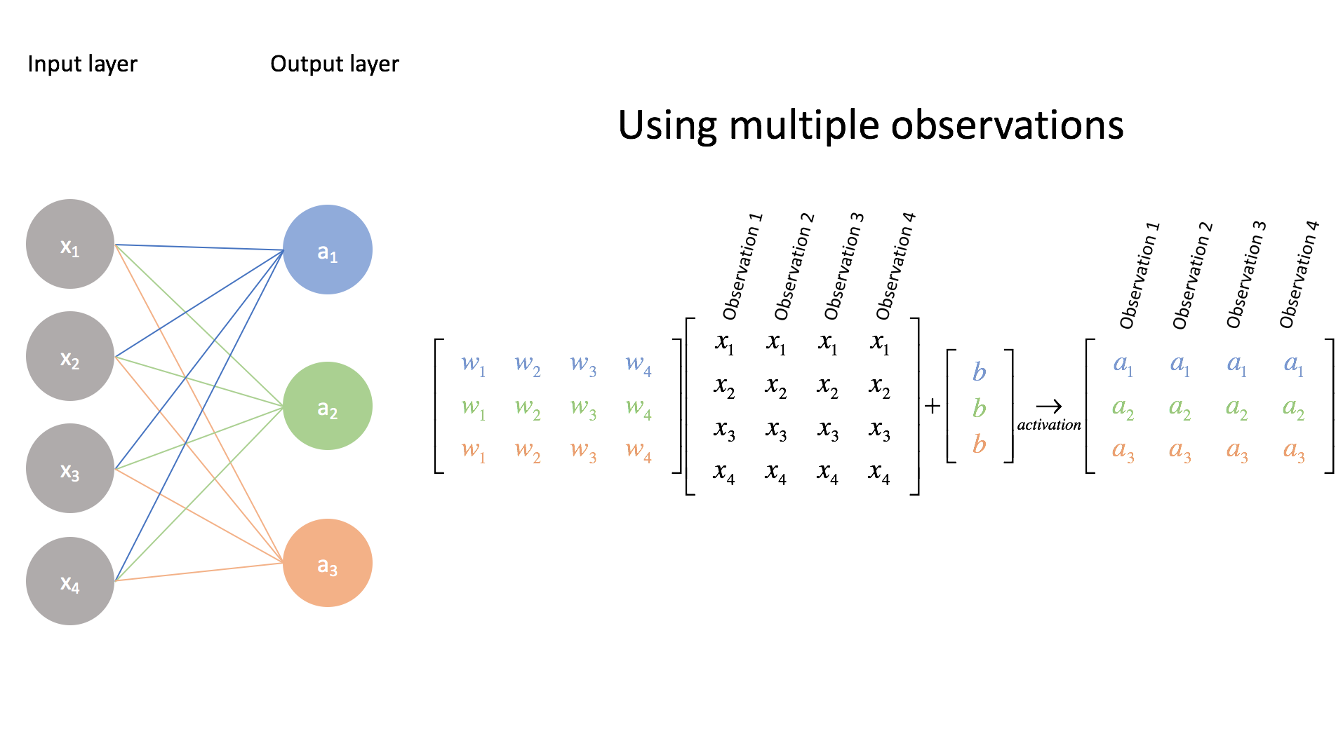

Deep learning for GPUs
To a first approximation deep learning is matrix multiplication + activation
rectified linear unit (ReLU)
+
One layer in a neural network
(Jordan, 2017)
Notes:
Neural networks: representation. Jeremy Jordan
JEREMY JORDAN
28 JUN 2017
https://www.jeremyjordan.me/intro-to-neural-networks/

Slide 21
Back Propagation is just the chain rule
How change the parameters to change the output a small amount
Forward pass:
y = h(g(f(x)))
f
g
h
x
y
W₁
W₂
W₃
Backwards pass:
y’ = h’(g(f(x))) g’(f(x)) f’(x)
f
g
h
x
y
W₁
W₂
W₃

Slide 22
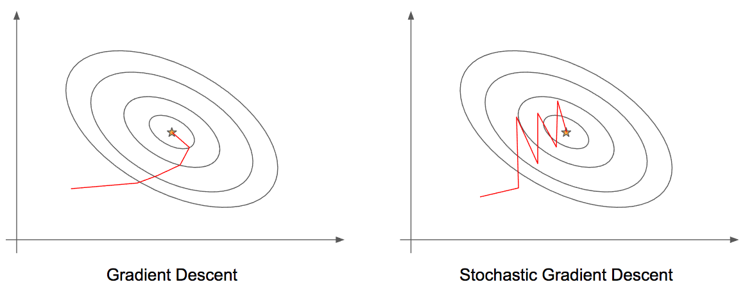
Stochastic Gradient Descent
Sample minibatch of data
Compute gradient of loss wrt. to minibatch
Update parameters
Scales to very large data
Unbiased estimate of gradient => convergence
Batch size controls ”temperature”
(Deshpande, 2017)
(Deshpande, 2017)
Notes:
https://pythonmachinelearning.pro/complete-guide-to-deep-neural-networks-part-2/
Complete Guide to Deep Neural Networks – Part 2
20/09/2017 by Mohit Deshpande

Slide 23
Ingredients for deep learning success
Effective utilization of graphical processing units (GPUs)
Automatic differentiation
Stochastic gradient descent
Over-parameterization
Under-parameterization: bias/variance trade-off => generalization
Over-parameterization: big-data + regularization => generalization
Trainable simulations
Plug-and-play differentiable modules
Encode data invariants
Generative models <---> simulations

Slide 24
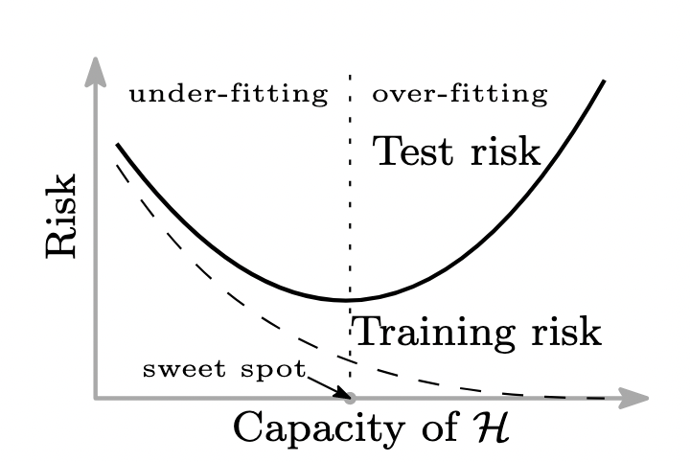
Under parameterization

Slide 25
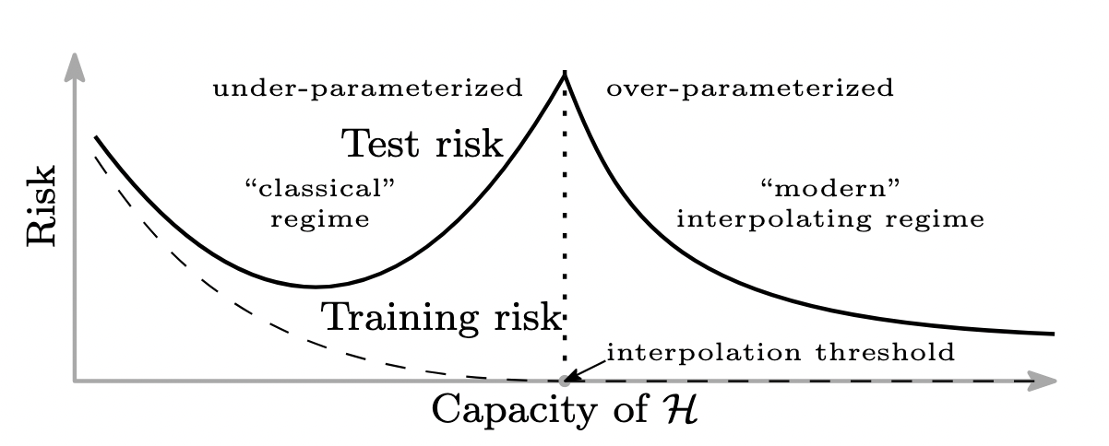
Over parameterization
(Belkin, et al., 2019)
Notes:
https://arxiv.org/abs/1812.11118
Reconciling modern machine learning practice and the bias-variance trade-off
Mikhail Belkina, Daniel Hsub, Siyuan Maa, and Soumik Mandal

Slide 26
Ingredients for deep learning success
Effective utilization of graphical processing units (GPUs)
Automatic differentiation
Stochastic gradient descent
Over-parameterization
Under-parameterization: bias/variance trade-off => generalization
Over-parameterization: big-data + regularization => generalization
Trainable simulations
Plug-and-play differentiable modules
Encode data invariants
Generative models <---> simulations

Slide 27
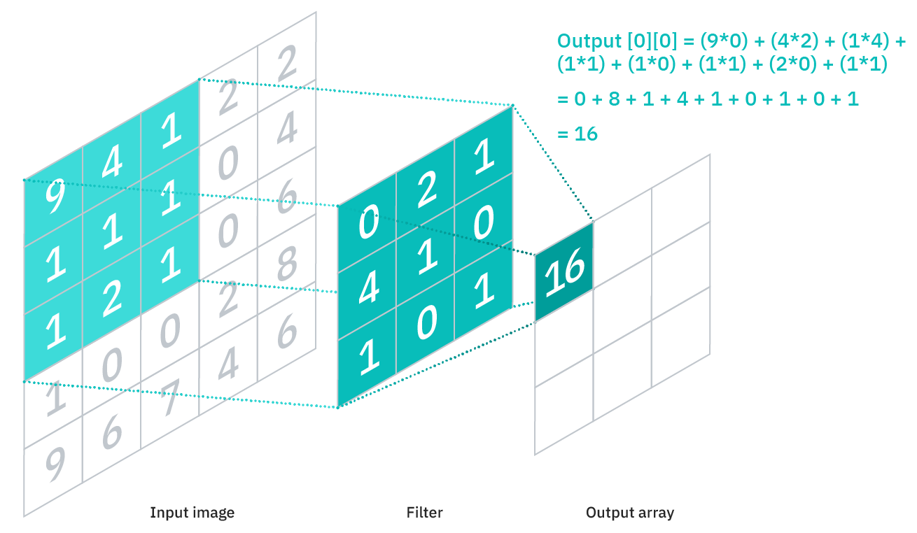
Convolutional neural network

Slide 28
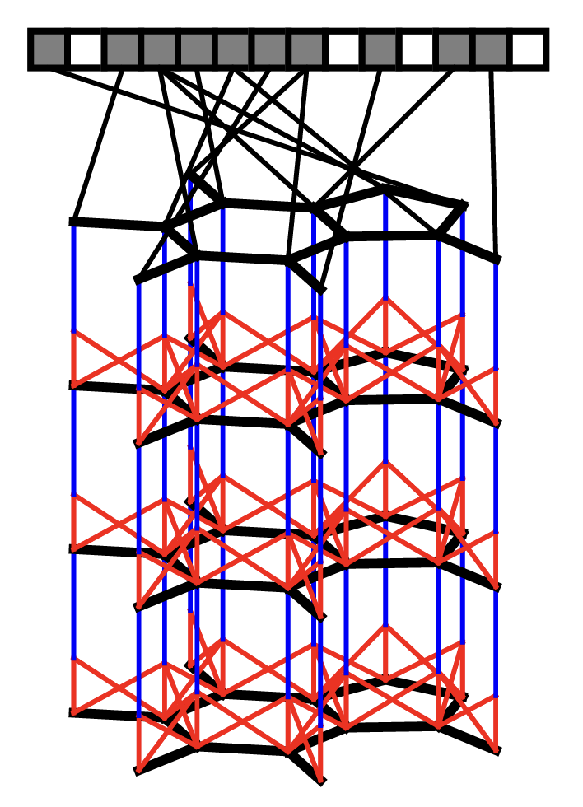
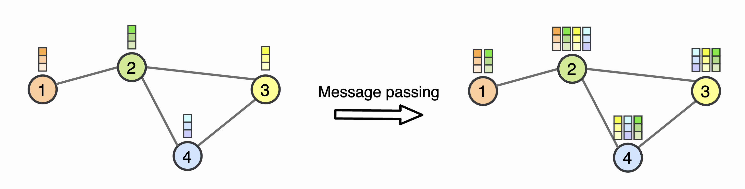
Graph Convolutional Network Similar to ECFP fingerprints but with learned weights
(Duvenaud, et al., 2015)

Slide 29
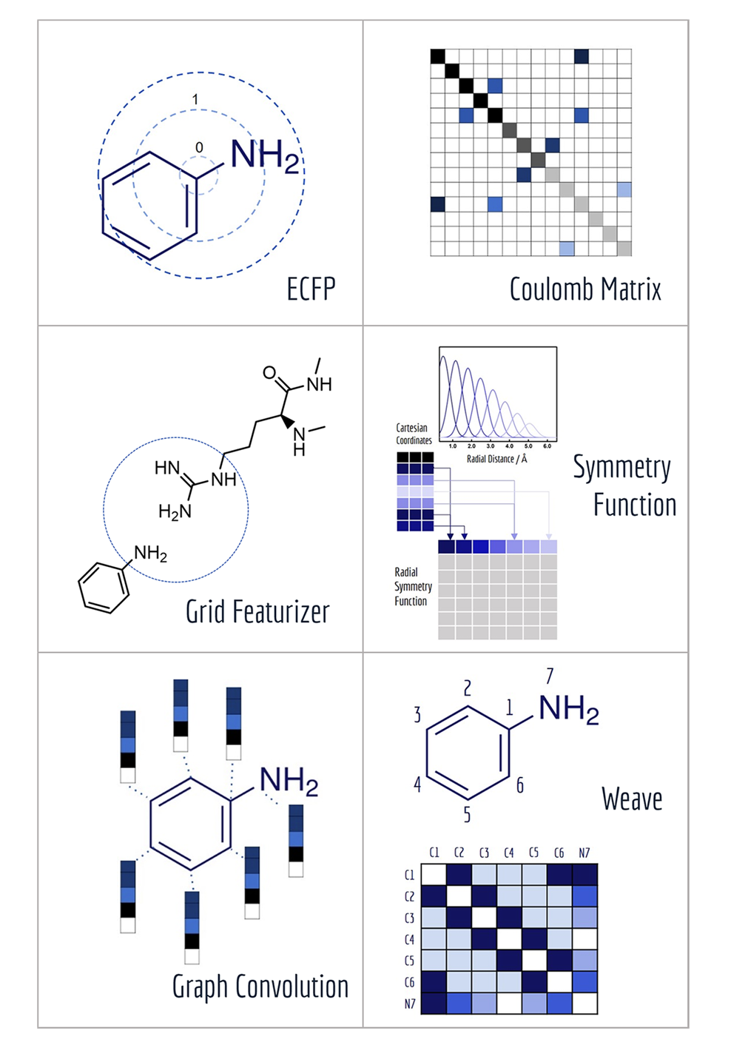

Featurization of molecules
DeepChem package
Good set of tools for building and testing ML form molecules
MoleculeNet is their testing benchmark/framework
(Wu, 2018)
Important to take handle symmetries of the data
Rotation/translation
Relabeling of atoms
=> E(3) space group
Notes:
MoleculeNet: A Benchmark for Molecular Machine Learning arXiv:1703.00564v3 [cs.LG] 26 Oct 2018
Zhenqin Wu,†,Bharath Ramsundar,‡,Evan N. Feinberg,¶,⊥ Joseph Gomes,†,⊥ Caleb Geniesse,¶ Aneesh S. Pappu,‡ Karl Leswing,§ and Vijay Pande∗,
https://arxiv.org/abs/1703.00564

Slide 30
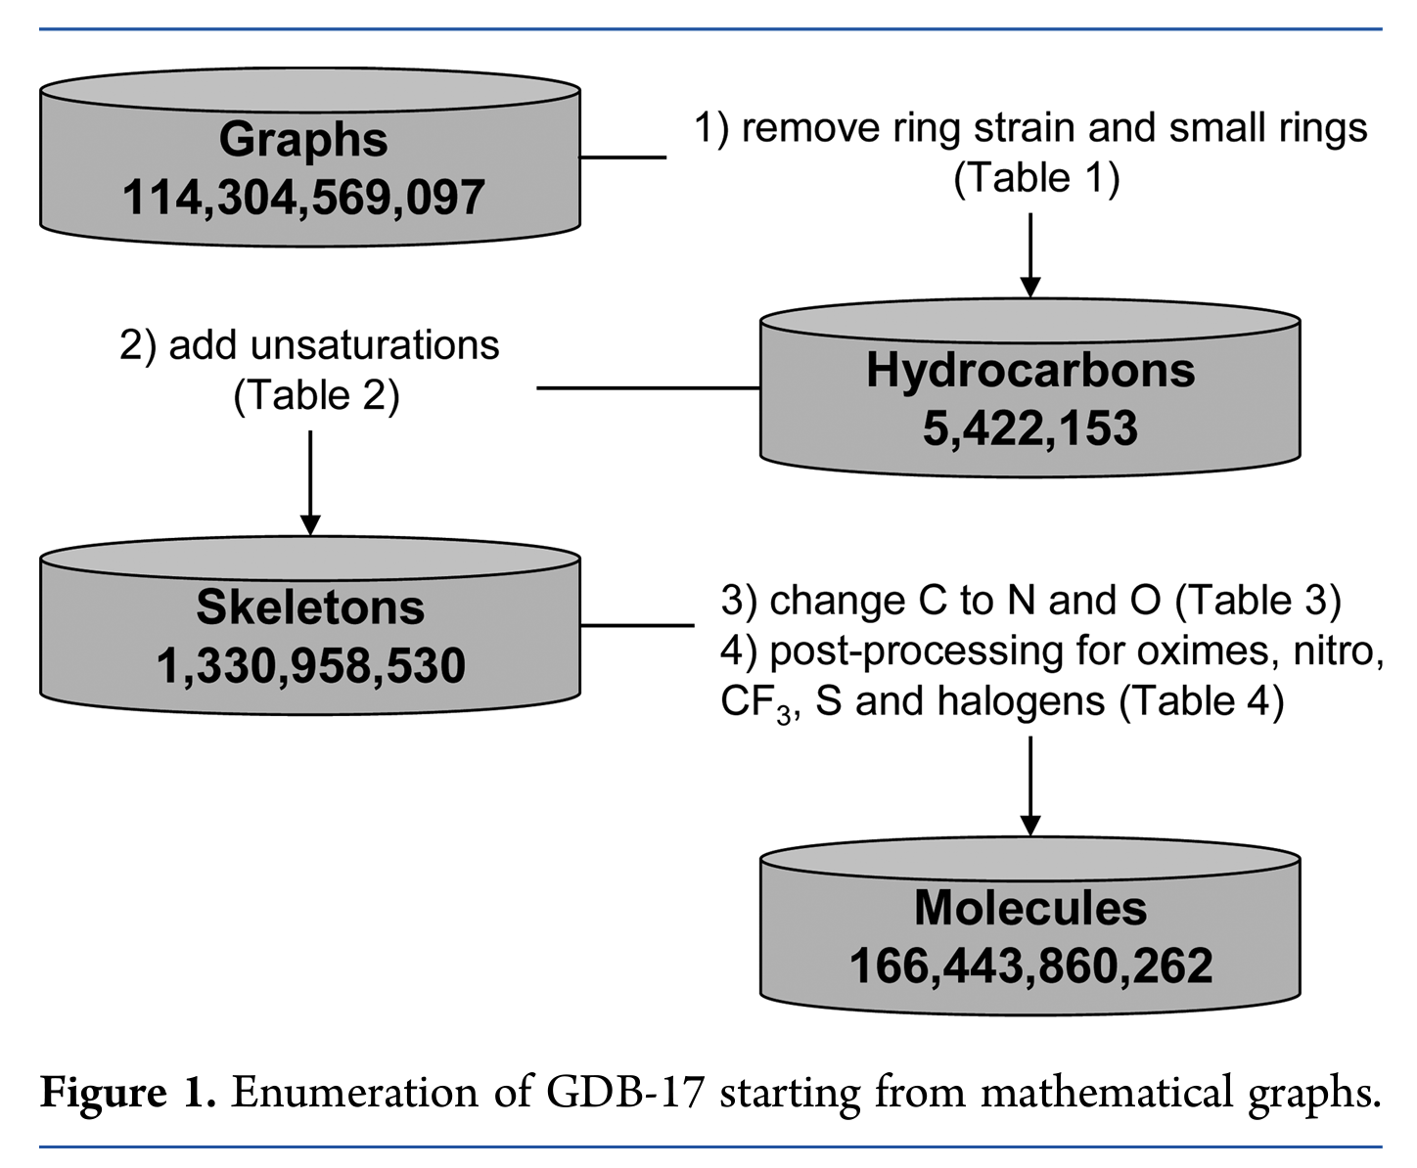
QM9 (Quantum Machines 9) dataset
GDB-17: Enumeration of 166 Billion
Organic Small Molecules
QM9
All molecules up to 9 heavy atoms
133,885 molecules
Minimized geometry
Quantum chemistry properties
(Ruddigkeit, et al., 2012)
(Ramakrishnan, et al., 2014)

Slide 31
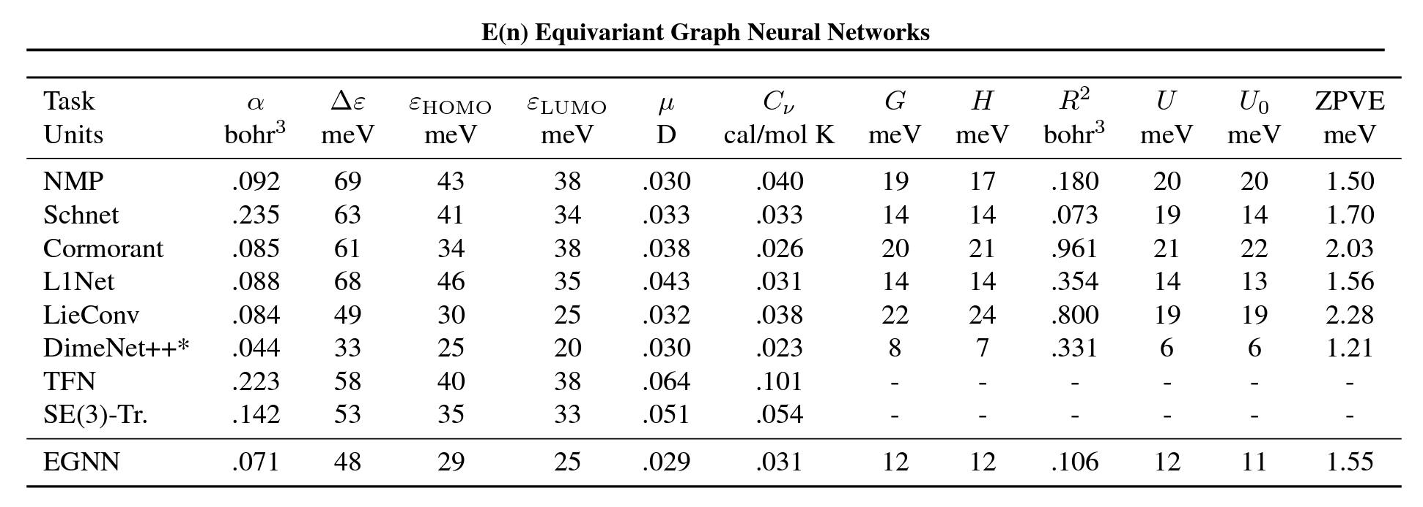
E(3) Equivariant Network state of the art on QM9

Slide 32
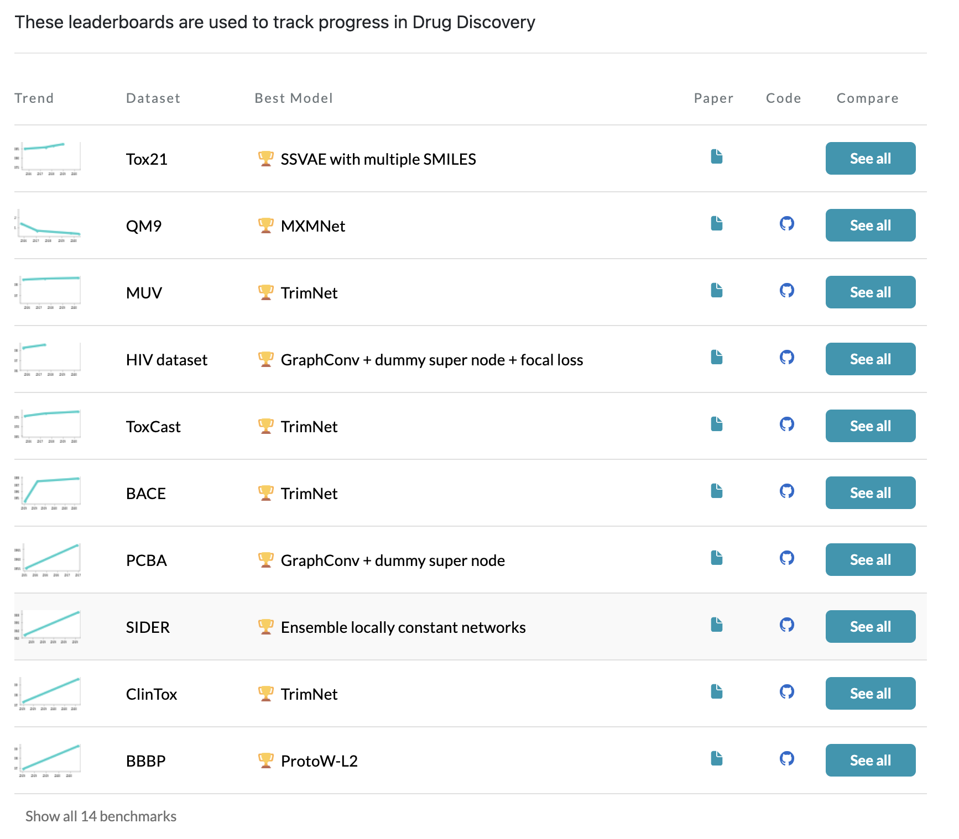


https://paperswithcode.com/task/drug-discovery

